Slide 1

CS 533 INTRO TO DATA SCIENCE
Michael Ekstrand

Slide 2
PYTHON ERRORS

Slide 3

Learning Outcomes
Read a Python error message
Understand common kinds of Python errors
Photo by Wesley Tingey on Unsplash

Slide 4
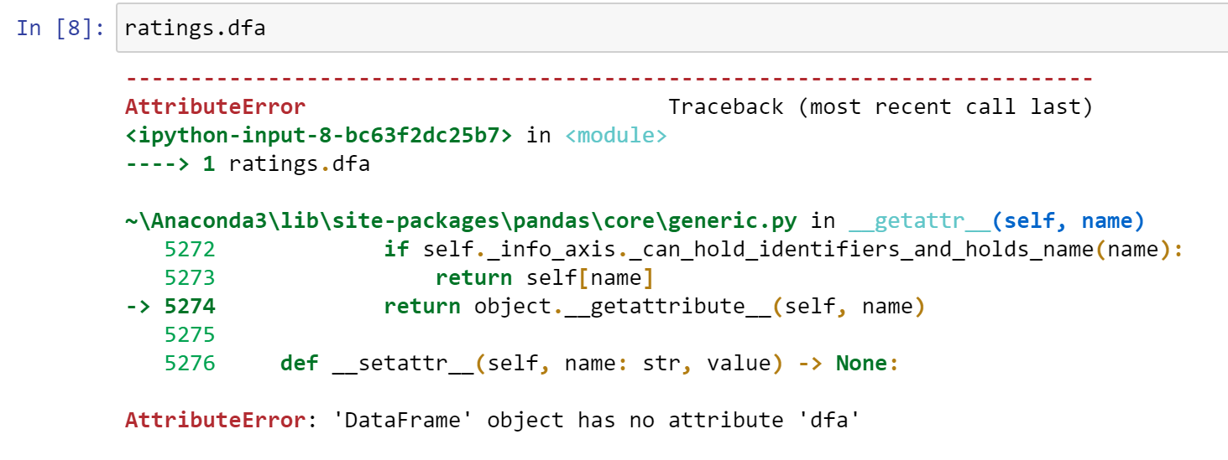

Stack Trace

Slide 5
Stack Trace Components
Error type
Location in the code
Error information (type + message)

Slide 6
Common Error Types
NameError – trying to use a variable that does not exist
AttributeError – trying to use a class member (method or field) that does not exist
KeyError – trying to look up a key (in a dictionary or Pandas index) that does not exist
Sometimes arises when Pandas doesn’t correctly figure out how to process the thing you’re using to index
IndexError – accessing an item by a position (in a list or with Pandas .iloc) that is out of bounds

Slide 7
Common Error Types
FileNotFoundError – trying to access a file that does not exist
Reading: the file does not exist
Writing: usually the directory doesn’t exist
OSError – other error reading/writing a file

Slide 8
Reading an Error
What kind of thing went wrong? (error type)
What specifically went wrong? (message sometimes helps)
Where did it go wrong? (stack trace)
Key is to understand what went wrong, in your code.
Copying errors into Google often doesn’t help.
Need to understand problem, and translate back to your context
Understanding helps you learn, but sometimes hard

Slide 9

Wrapping Up
Python errors are reported by exceptions.
The stack trace shows you where in the code the exception occurred.
raise WatercraftInversionError
Photo by Quino Al on Unsplash

